Slide 1


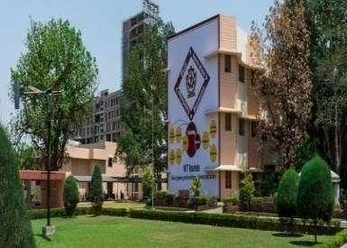


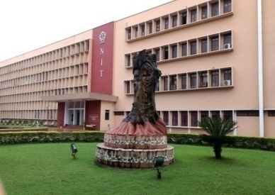
DATA COMMUNICATION (CS 3001)
National Institute of Technology Rourkela

Slide 2
What is Data Communication ?
Data Communication refers to the exchange of information/data between two devices using a communication link and
based on some protocols and standards.
Information or Data: message
Communication Link: Wired or wireless medium
The Communication system:
Constitute both hardware and software
Should be both effective and efficient
Characteristics of DC system:
- Delivery: Data must be delivered to the correct destination in correct order.
- Accuracy: Error free data at the receiver end/Malfunctioned data remain unusable
- Timeliness: Arrival of data at the right time
- Jitter : Delay in sending the data (Its impact on audio and video quality)
Caused due to either congestion or route change (Standard duration is 15 to 20 ms)
High jitter may lead to data loss (What is acceptable jitter in different applications)
Good jitter: (According to CISCO)
- Below 30 ms,
- Data loss needs to be < 1%
- Latency (RTT) < 300 ms
Effectiveness & efficiency of data transfer depends on above 4 characteristics.

Slide 3
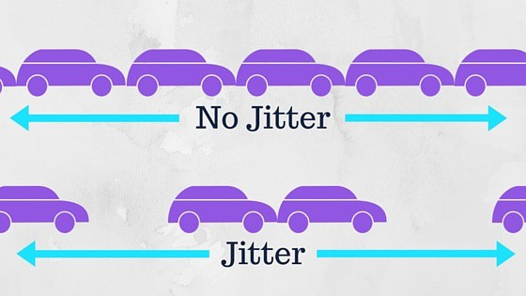
Jitter

Slide 4
Components of DC System
Message: Data or information to be exchanged (Ex. Voice, text, video, images, numbers etc,)
Sender : The device that sends data (Ex, PC, Mobile, Camera etc,.)
Receiver: The device that receives the data (Ex. Printer, Plotter, Computer, Mobile Phone etc.)
Protocol: A set of rules and regulations to allow the exchange of data between two communicating devices
Transmission Medium: The Physical path to transmit the data b/n sender and receiver (Ex. Twisted pair cable, Optical fibre, wireless etc.)

Slide 5
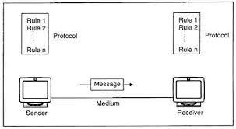
Components of DC System

Slide 6
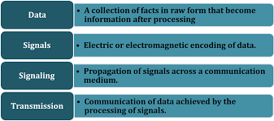
Data Communication System

Slide 7

A Simple Data Communication System

Slide 8
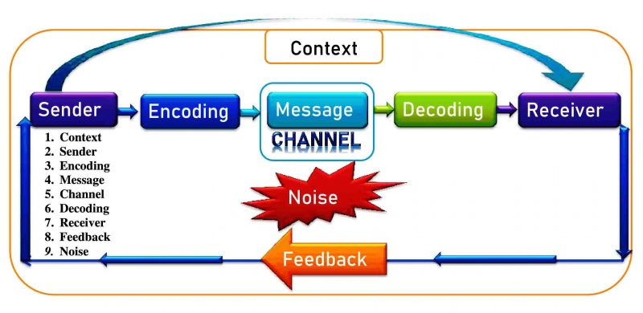
9 Elements of Entire Communication Process

Slide 9
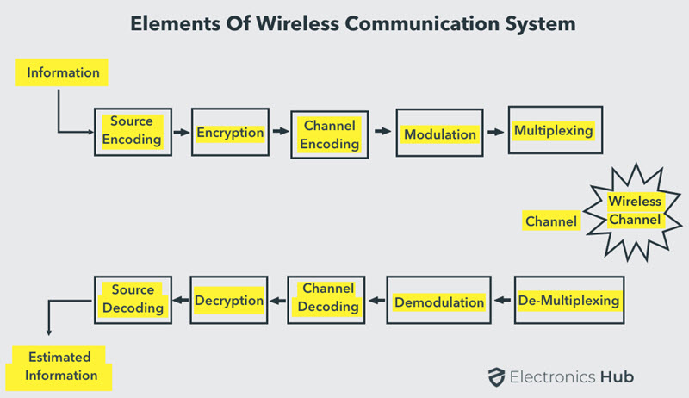
Elements of Wireless Communication System

Slide 10
Wireless Communication
Advantages: Cost, Mobility, Ease of installation, Reliability, Disaster Recovery
Disadvantages: Interference, Security, Health Concerns
Basic Elements: Transmission Path, Reception Path & The Channel
Types of Wireless Communication Systems: TV & Radio Broadcasting, Satelite Communication System, Mobile Telephone, GPS, Bluetooth, Infrared, UV rays, WLAN, WWAN, WSN, VANET, MANET etc.

Slide 11
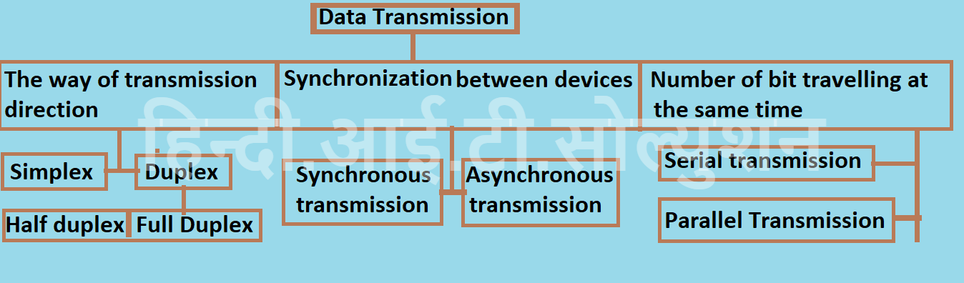

Slide 12
Transmission Modes
Simplex: Communication occurs in one direction only
Microphone to Speaker (Unidirectional)
Half Duplex: in both directions but not at the same time
Police Car Radio Phones (Bidirectional)
Full Duplex: occurs in both directions but at the same time
Telephone IP Service (Bidirectional)

Slide 13
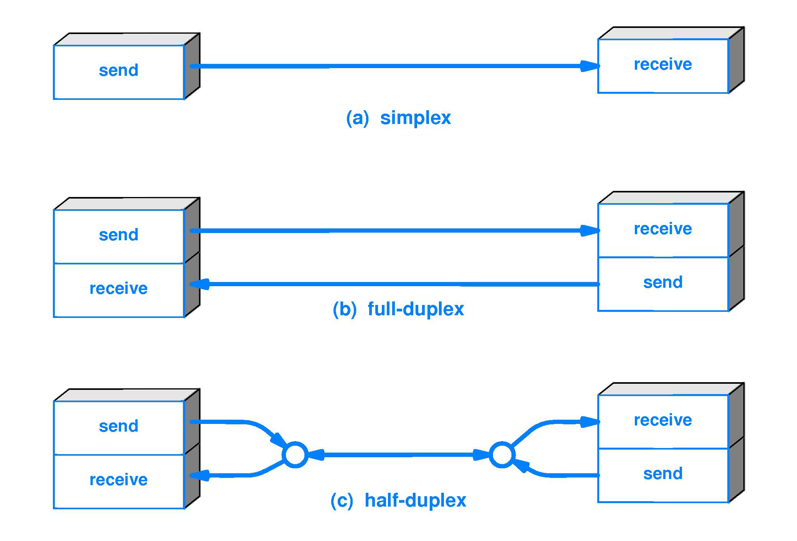
Transmission Modes

Slide 14
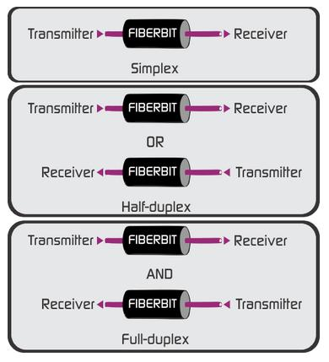
Transmission Modes

Slide 15
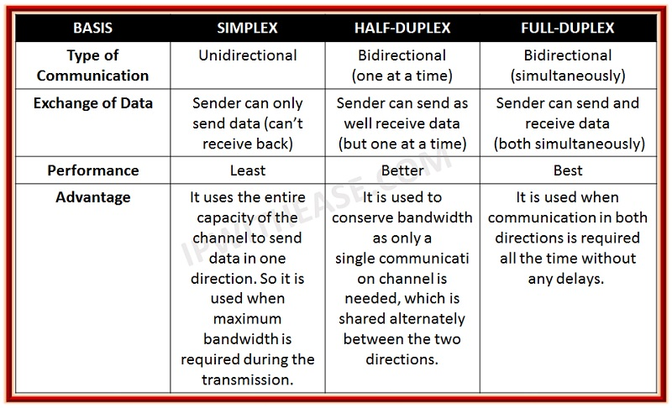

Slide 16
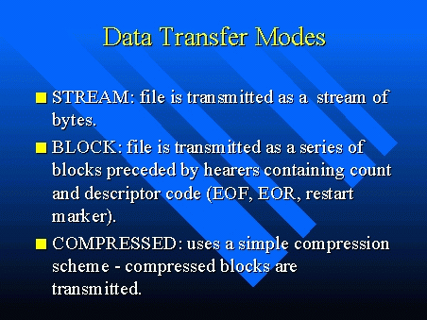

Slide 17
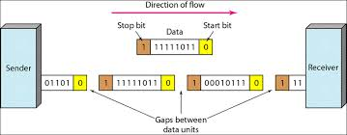
Asynchronous Communication

Slide 18
Asynchronous Data Transmission
Data is sent in form of byte or character.
Half duplex type transmission.
Start bits and stop bits are added with data.
Does not require synchronization.

Slide 19

Synchronous Communication
SYN: Special Synchronized Character
SOH: Start of Header
STX: Start of Text
ETX: End of Text
CRC: Cyclic Redundancy Check
Data is sent in form of blocks or frames.
Full duplex type.
Synchronization is compulsory b/n Sender and Receiver.
No gap present between data.
More efficient and more reliable than asynchronous transmission to transfer the large amount of data.

Slide 20
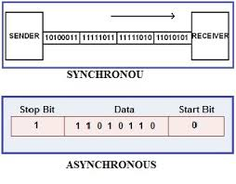

Slide 21
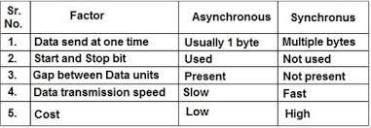

Slide 22
Synchronous Transmission Asynchronous Transmission
1. Data is sent in form of blocks or frames. Data is sent in form of byte or character.
2. Fast. Slow.
3. Costly. Economical.
4. Time interval of transmission is constant. Time interval of transmission is not constant, it is random.
5. No gap present between data. Gap between data.
6. Efficient use of transmission line Transmission line remains empty during gap in character transmission.
Needs precisely synchronized clocks for the information of new bytes. No need of synchronized clocks as parity bit is used in this transmission for information of new bytes.

Slide 23
Example Scenario
Assume three Processes A, B & C
A & B wants to send data to C
Synchronous communication: C regularly polls A and B, requesting an input measurement. In effect, C sends a message to A asking for the next input, and must then wait until A has replied, before requesting input from B. Roughly speaking, C can do no useful work while waiting for A or B, and only one processor tends to be active at a time.
Asynchronous communication: A sends a message to C whenever it is ready, typically interrupting any processing done by C. A may either send messages autonomously or because of a previous request from C. Either way, when the message from A arrives, C is probably occupied on urgent business of its own and won’t be ready to deal with it. Typically, the message from A will cause an interrupt, invoking a procedure within C that temporarily seizes control.

Slide 24
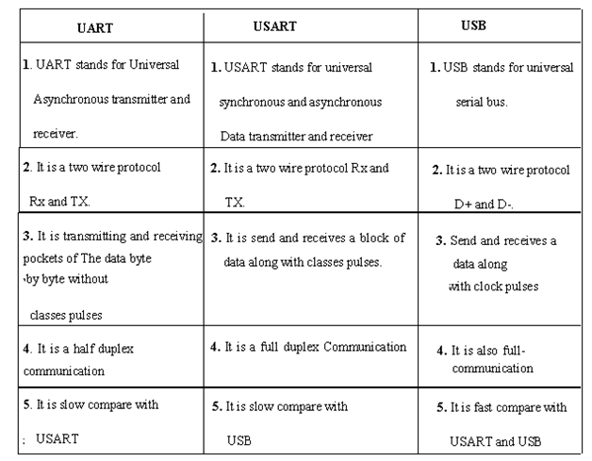

Slide 25
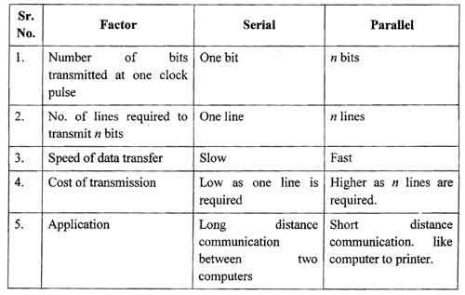

Slide 26
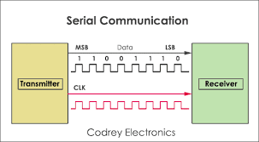

Slide 27
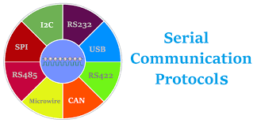

Slide 28
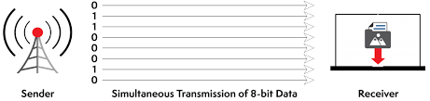

Slide 29
References
https://newsmoor.com/communication-elements-9-components-of-basic-communication-process/
https://www.electronicshub.org/wireless-communication-introduction-types-applications/
https://slidetodoc.com/internet-networking-local-area-network-wide-area-network/
https://fiberbit.com.tw/defining-simplex-half-duplex-and-duplex/

Slide 30

Thank You

